Slide 1
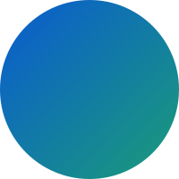




ITD334-MINI PROJECT
HEALTHICA-
HEALTH
ANALYSIS APP
GUIDE: Prof.Tinku Soman Jacob

Slide 2
Problem Statement
Most people may not be able to visit doctors or clinics every time they become sick or show any symptoms.They might also not be able to track their health and avail prolonged care. Healthica provides a variety of economical services from keeping track of medical prescription to understanding your physical and mental health.
Next Page

Slide 3
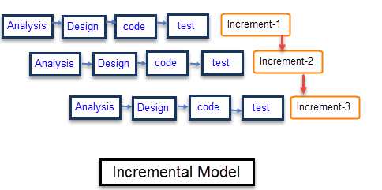
Agile Software Approach We Used:
Such Health Apps should be quickly made available in the market
Using this approach can give a product within the first few sprints
More Features and feedbacks can be added and incoprated

Slide 4
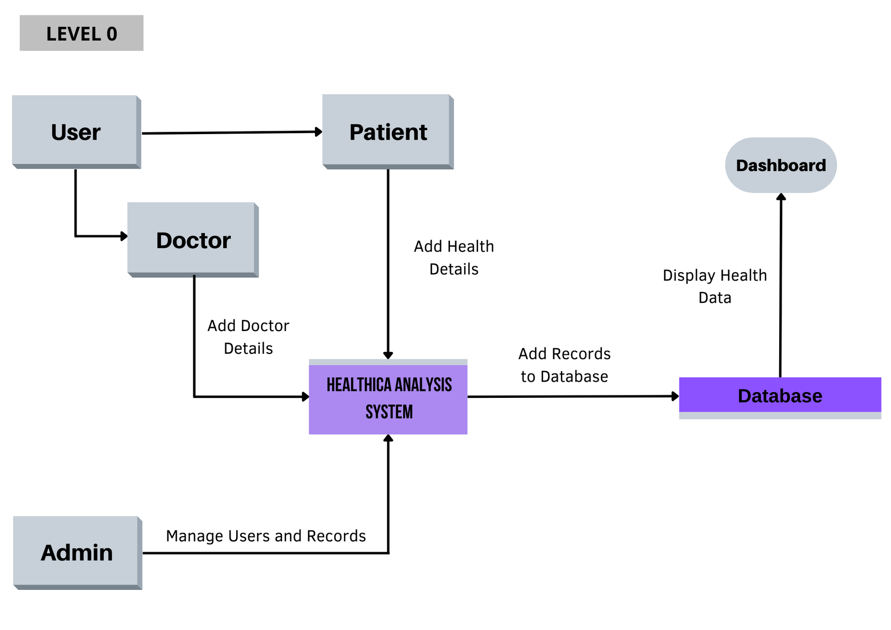
DATAFLOW DIAGRAM -LEVEL 0

Slide 5
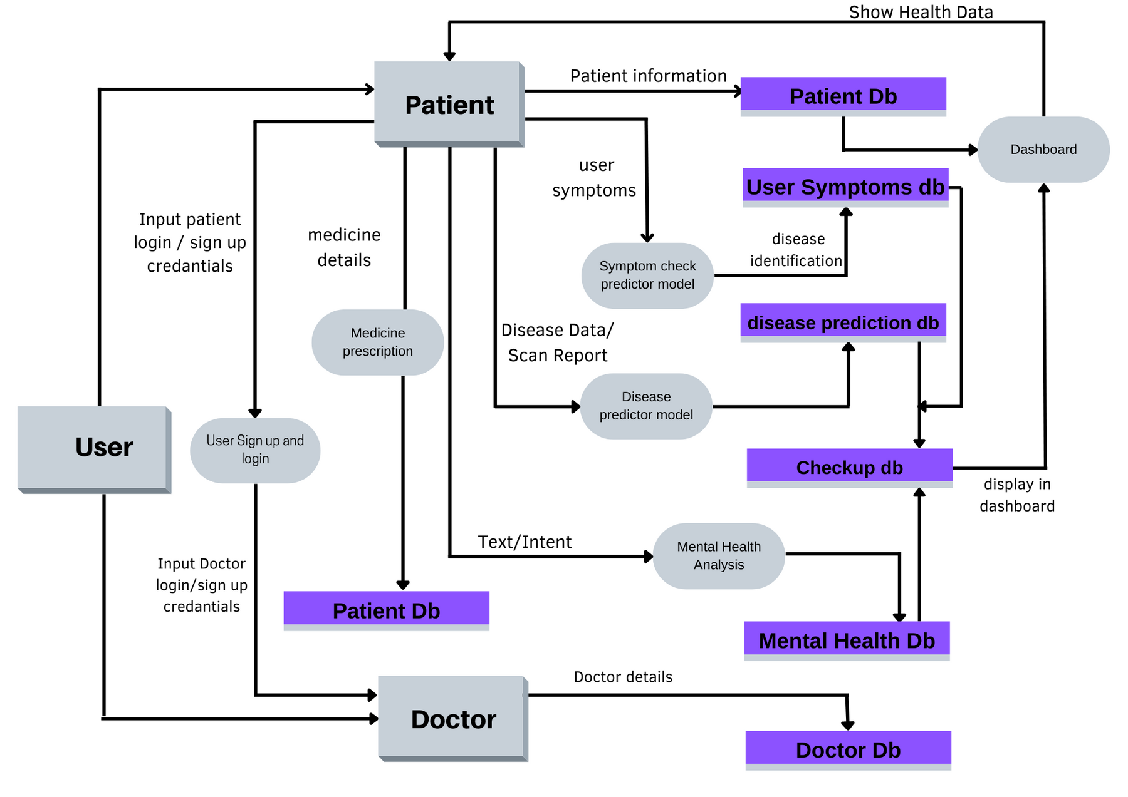
DATAFLOW DIAGRAM -LEVEL 1

Slide 6
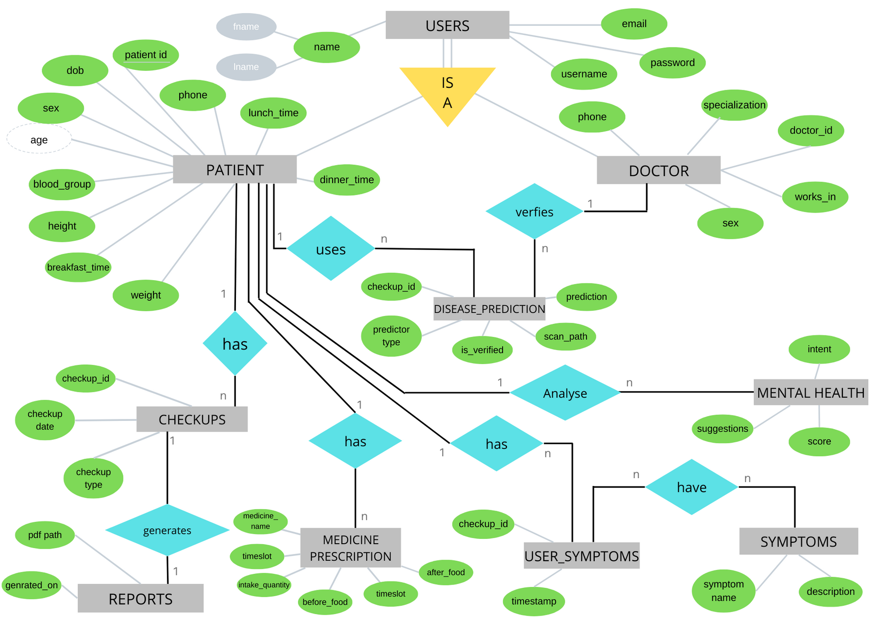
ER DIAGRAM

Slide 7
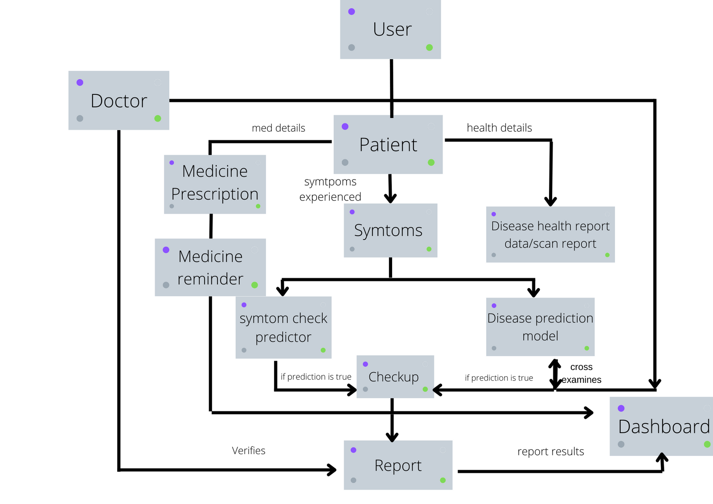
BLOCK DIAGRAM

Slide 8

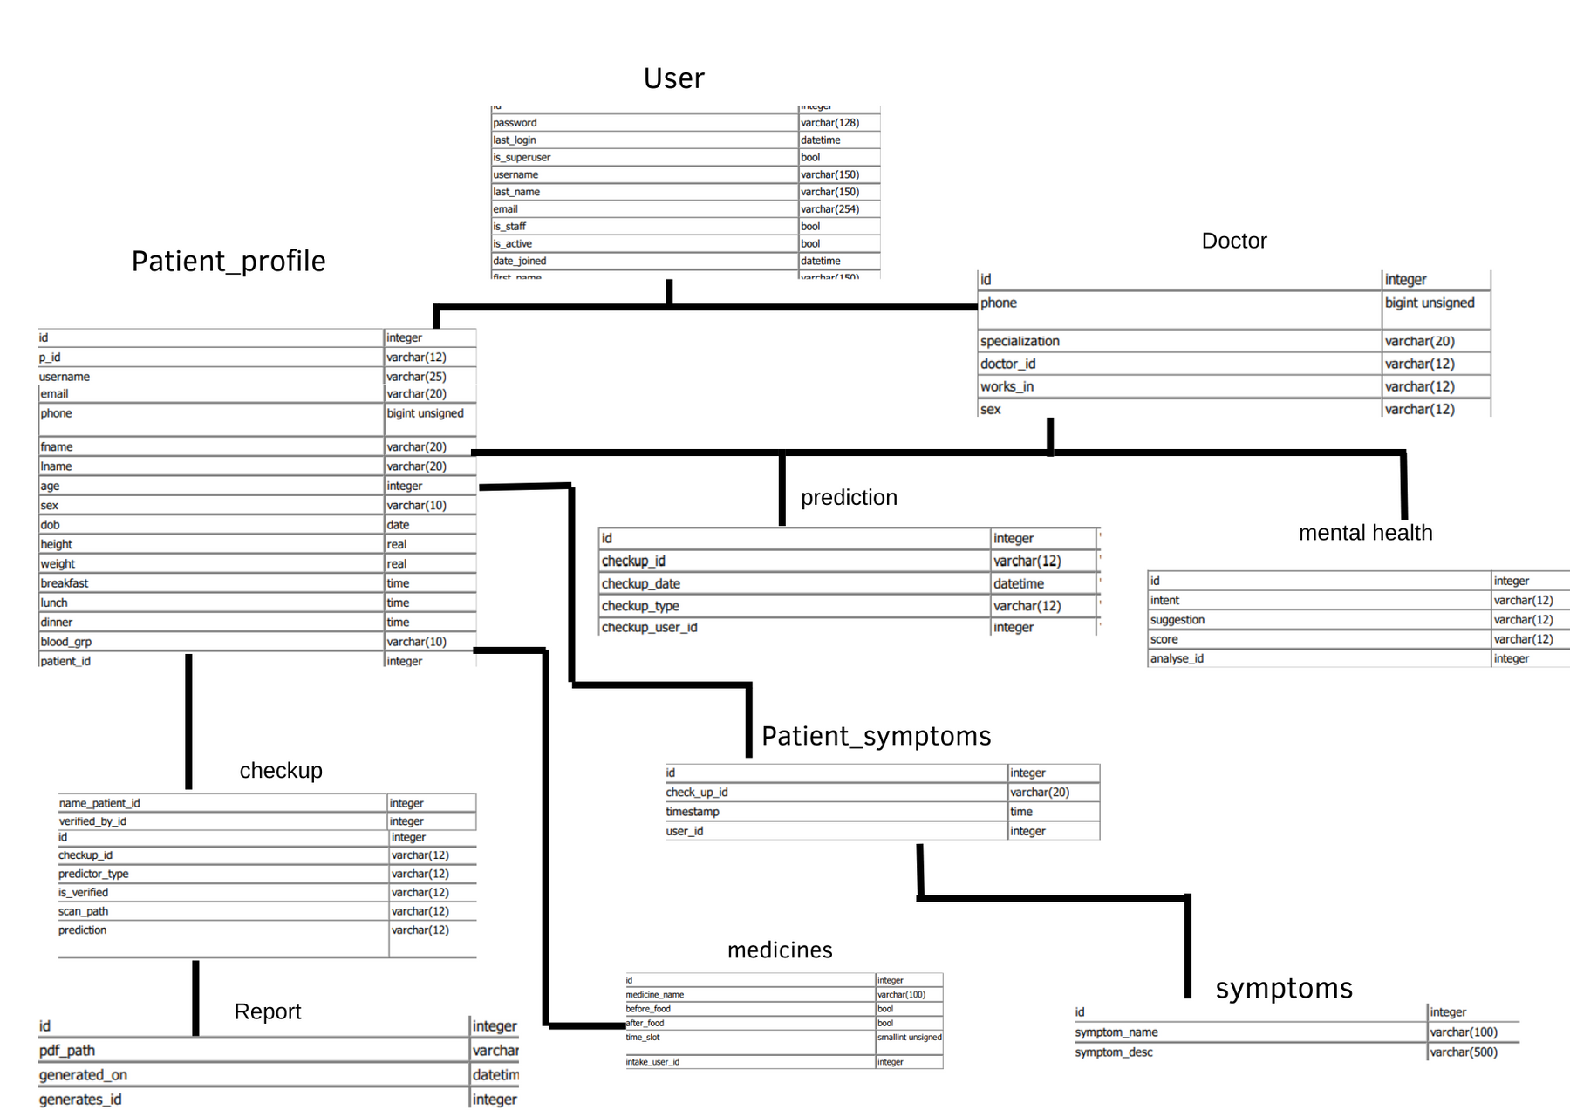
DATABASE DESIGN

Slide 9

HEALTHCARE
Main concepts/algorithm/techniques to solve the problem
Data Scraping using Beautiful Soup
Sentimentental analysis(NLP) for mental health
Python views and features
Django SMTP for Emails
Ajax for Realtime Web Data
Javascript Events
django channels for notifications
Machine Learning Algorithms Used for Predictors
Random Forest Classifier
Support Vector Machine
K Nearest Neighbours
Next Page
Get Started

Slide 10
MODULES INVOLVED IN THE PROJECT
1.User sign up module - User basic details
Doctor registration - doctors basic details
Patient registration- each patient to enter their details
2.User Login in- login credentials
3. Symptom check predictor- check diseases with provided symptoms.
4. Disease Predictor- ML model to predict various diseases
6. Report Dashboard- a patient's all checkup reports, health data, and results of the same.
7. Medicine details- information about the time slots and amount of intake.
8. Medicine reminder notification- reminder system to notify about medicine intake according to the time slots.
9.Mental health scoring- keep track of mental health issues related to each patient.
Next Page

Slide 11





Implementation details like platforms, IDE,Database
FRONT END DEVELOPMENT USING- HTML , CSS , JAVASCRIPT
BACKEND DEVELOPMENT USING- PYTHON DJANGO FRAMEWORK
DATABASES- SQLite3
Next Page

Slide 12



HEALTHCARE
Implementation details like platforms, IDE,Database
IDE Used: VS Code,Sublime Text
GITHUB: Code hosting and collaborating platform used here.
TRELLO:To Collaborate, manage projects a Web based,Kan ban style list making application for creating workspace for project management and task tracking.

Slide 13
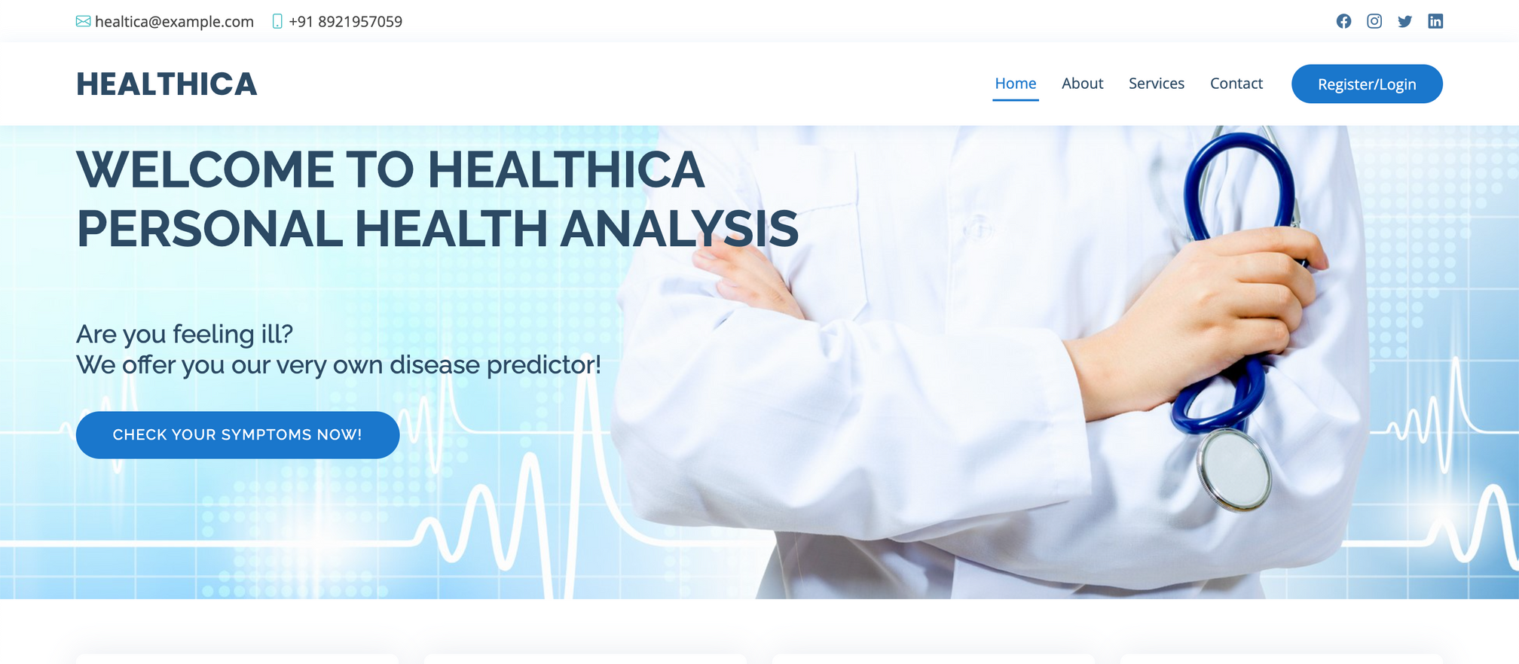
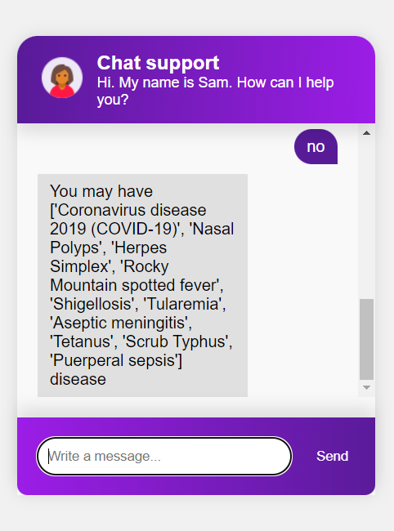
Sample Homepage Design

Slide 14
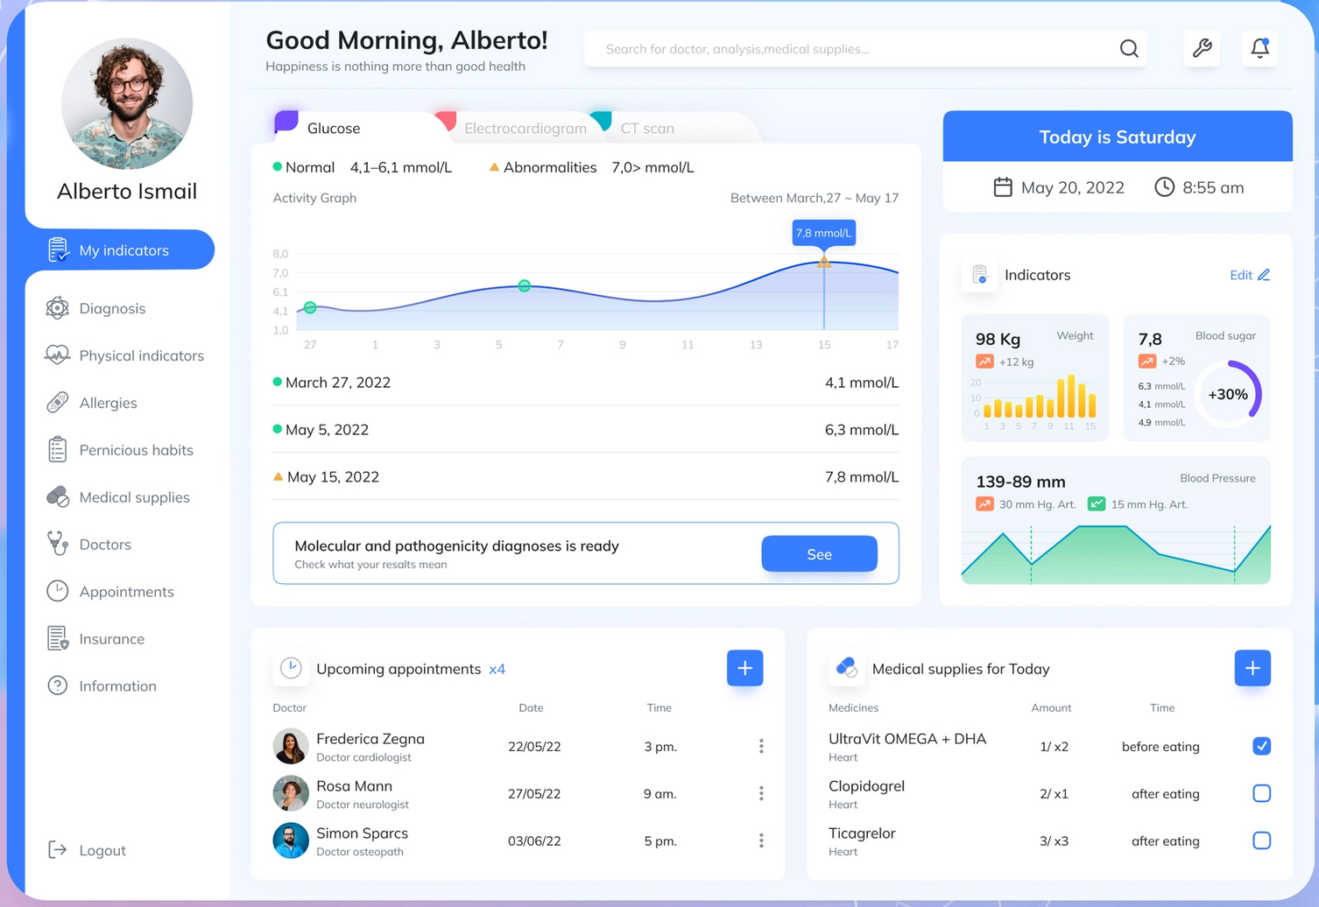
Sample Page Design

Slide 15
Task Assignment
Front End
Back End
Tasks:
Homepage- Ephram
User login & Registration- Abhijith
Dashboard-Abhijith and Ephram
Document adding feature - Abhijith
Symptoms checker- Abhijith
Disease Predictor- Anand and Ephram
Tasks
Back end for:
Login details- Anand
Registration details- Devu Medical documents-Anand Health statistics- Devu
Disease Predictor- Ananad
Symptoms Checker- Devu
Next Page

Slide 16
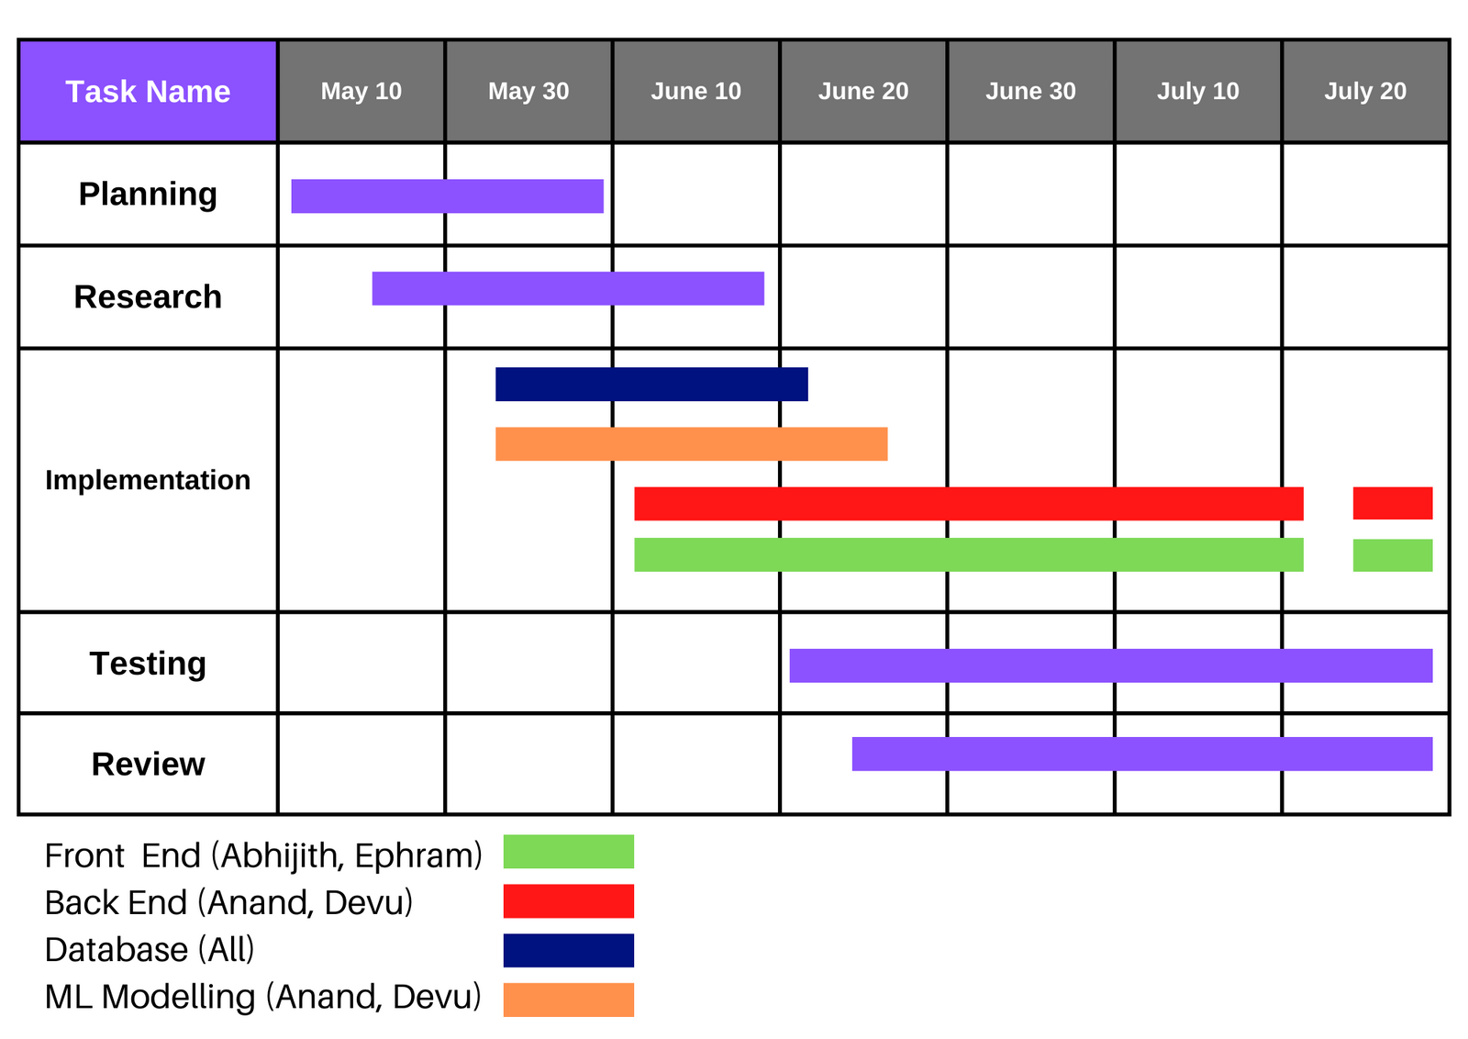
Project Schedule with a Gant chart and main responsibilities of each members

Slide 17
References/ literature study of existing
system under the chosen area.
https://www.webmd.com/
https://www.mayoclinic.org/
https://www.everydayhealth.com/
https://www.healthline.com/
Next Page

Slide 18
Thankyou
Next Page

